Slide 1

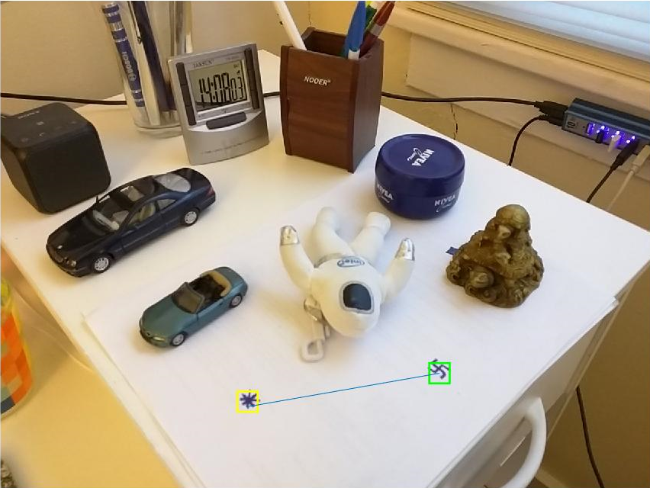
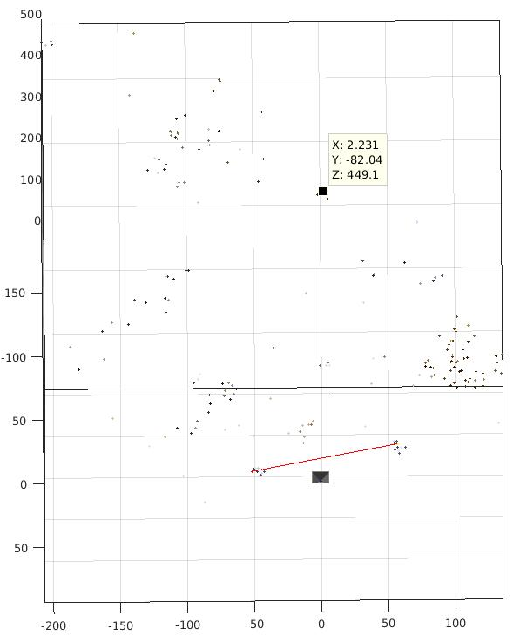
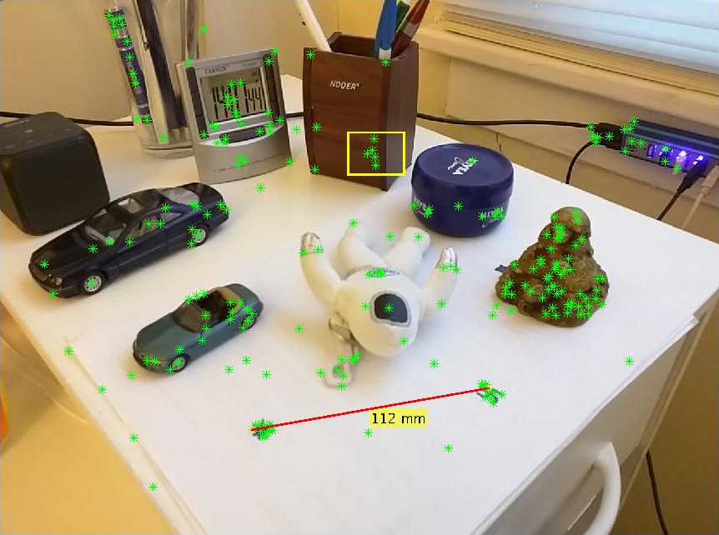

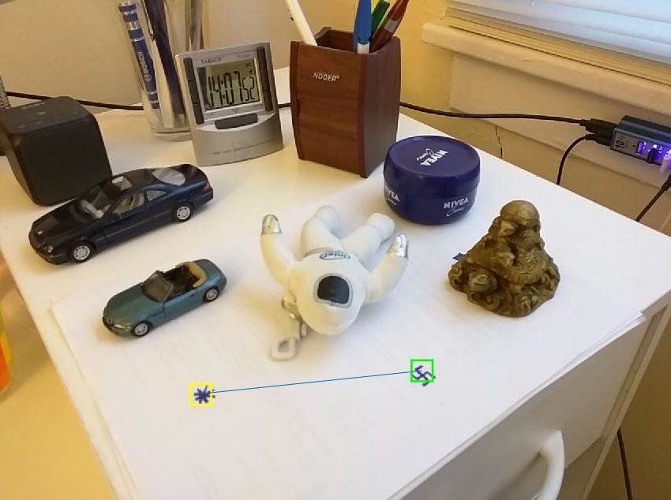
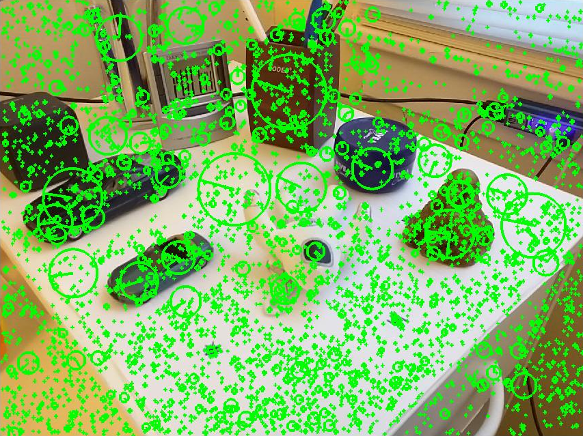
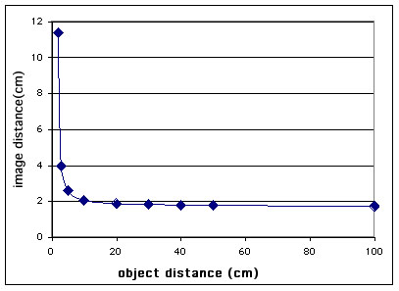
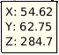
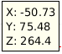
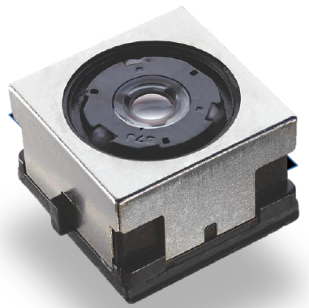
Instant Auto-focus using Structure From Motion
- Jai Prakash and Mengxin Li (MSCV, RI, CMU)
Motivation:
Range Finders - Manual
Active AF - Sonar, IR Triangulation
Passive AF
Triangulation (CCD, solid state)
TTL Phase detection
Contrast detection (Hill climbing)
Hybrid AF (and Dual Pixel)
SFM based AF:
Scale Ambiguity
Tracked based solution
Inertial Sensors
Real-time SFM
Focus should be constant
SFM with scale resolved
Focus request
Locate
Tracker
Focus Calibration
data
SIFT Features
Move
Actuator

